Slide 1
The Digital Insurer How Insurers Can Unlock the Digital’s Potential
June 26, 2014

Slide 2

Big Bang Disruption
Disruptive technological innovations have historically started out cheap and simple, gradually improving until they challenged incumbents
Today, new products are perfected with a few trial users and then embraced quickly by the market, wiping out incumbents in a flash
Regulated industries are especially vulnerable
When the law limits competition, businesses have little incentive to innovate
Once the disrupter finds a way in, the collapse is much more sudden

Slide 3
Three things that have to be true to create technology intensive disruption
1
Technology changes the balance of power between the enterprise, its customers, consumers and trading partners.
People have new power or make new decisions.
Innovation creates new value and cost equations, moving the frontier of competition.
Being efficient is no longer sufficient.
Players in the market are actively creating the change.
Leaders set the pace for the market.
2
3

Slide 4
The exponential growth of technology is reshaping the adoption curve
Market
Penetration
Enormously desirable products and services that are:
Better
Cheaper
Closer to the customer
Take off quickly creating “Big Bang Disruption”
Today
Historically
Time
Copyright © 2014 Accenture All rights reserved.
4

Slide 5


Disruptions in Financial Services
Provides Asset Based Lending underwritten by actual web traffic and click conversion rates of Amazon resellers. They do not need financial statements for underwriting and distribute proceeds using current payment channels.
Financial Services
Life Insurance Corporation of India markets, sells and services life insurance policies via mobile devices. Underwritten by the applicants mobile phone payment and prepayment history.

Slide 6

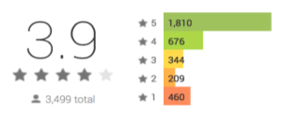
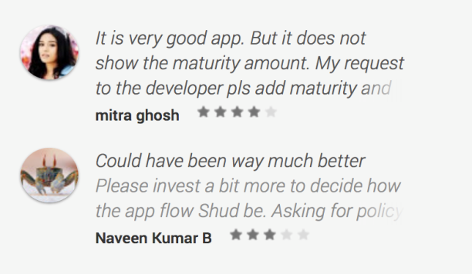
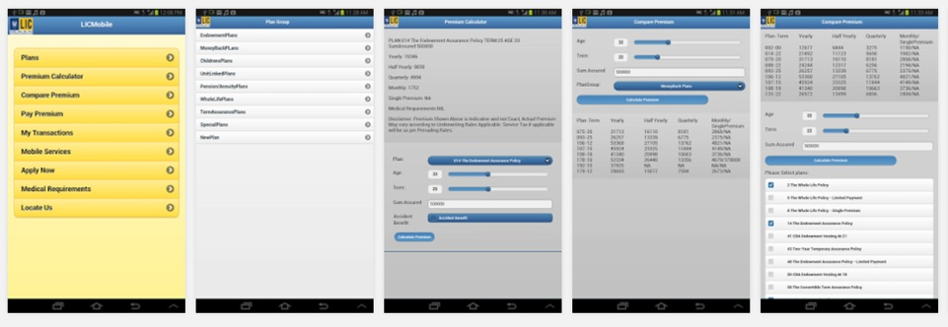
LIC: Life Insurance Corporation of India
Launched February 4, 2014

Slide 7
Digital Transformation reflects a staged journey from establishing your position to disrupting your industry.
Business Benefits
Disrupt
Growing digital by redefine the terms of competition
Earn a Digital Premium
Differentiate
Participate with Digital Customers
Being digital by delivering a new price/value and experience equation
Defend
Position Digital Channels
Feeling digital as the company re-platforms channels, sales and service
Time

Slide 8
Customers are willing to adopt of new channels for insurance.
When did you first purchase insurance through the following channels?
Channels used for over 2 years
Most recent channels
< 2 years ago
>2 years ago
38%
39%
39%
52%
57%
60%
62%
62%
61%
61%
48%
43%
40%
38%
Your employer
Independent
agent/broker
Insurance
agent
Bank
Insurance company
telephone service
Retailer
Online
8

Slide 9


The ‘switching’ economy for insurance is estimated at $400 billion in premium
Personal-lines P&C and life insurance worldwide, 2013
Total premiums multiplied by the switching factor
Notes:
The size of the switching economy is estimated as the total of personal-lines property and casualty and life insurance premiums written in a 12-month period multiplied by the percentage of customers who reported they are likely to switch providers in “the next 12 months.” For P&C insurance the definition of switching is cancelling or not renewing a contract with one provider and initiating a new contract with another. For life insurance the definition is cancelling or stopping contributions to a contract with one provider and initiating a new contract with another provider. Investment policies held with life insurers are excluded from the calculation.

Slide 10
Digital Business vs. Digitizing the Business
Revenue
Being Digital
Combining new technology with new operations
New & New
Feeling Digital
Applying new technology to old operations
Digital Business
Today
New & Old
Digitize Processes
Cost/Margin

Slide 11
Digital high performers in financial services industry outcompete their peers over time
Digital Maturity
High
8.
Very Large Asset Mgmt. Company
3.
6.
1.
Large P&C Company
2.
Large P&C Company
4.
Low
-30%
-20%
-10%
10%
20%
30%
40%
50%
14.
Large Life Insurance Company
5.
10.
13.
Large Life Insurance Company
7.
Market Share % Improvement (2008-2013)
Notes:
A number of digital high performers have improved their market share 10% - 40%
Some financial services providers with lagging digital maturity have experienced 10% to 20% declines in market share

Slide 12

It’s time for a different definition of Digital

Slide 13
We need a different definition of digital.
People x Capability^^{Information}
Technology Connections
Digital (adj.) increasing information intensity and connectedness of customer and business resources.
Digitize (verb) applying technology to customer and business resources.
Digital Business (noun) an organization that incorporates digital technology to create revenue and results via innovative strategies, products, processes and experiences.
13

Slide 14





The challenge is to invent products and services so beloved by customers that they will pay more for them
Companies that lead in customer satisfaction:
Design from the customer’s perspective “outside-in”
Integrate all channels and customer touch points
Execute flawlessly and consistently across touch points
Continuously upgrade products and services
Make digital core to the business model
14

Slide 15




Things to get right in building a digital business
Picking your spots – becoming too focused to fail with digital initiatives.
Re-orienting the business from what you do to why people should choose you.
Building and partnering to get the right talent and people in the organization.
Creating a more dynamic operating model and governance structures to respond to market changes.
Copyright © 2014 Accenture All rights reserved.

Slide 16
Becoming a digital business is different from digitizing marketing or operations
Digitize Marketing
Digital
Business
Revenue
Digitize
Channels
Digitalize Business Models
External
Focus
Digitize Operations
Digitize Processes
Internal Focus
Margin
Copyright © 2014 Accenture All rights reserved.

Slide 17
How are we building digital capabilities?
Digital Business
Digital Marketing
Digitize Processes
Customer Experience
Increase access to sales and service channels
Reduce negative outcomes
Add analytics based contextualization
Increase digital and personalized marketing
Innovate products into information services
Raise customers’ human ability and capacity
Cross Channel Excellence
Consolidate channel operations
Deliver same response regardless of channel
Establish omni-channel consistency
Raise contact center skills and efficiencies
Contextually aware customer service
Second moment of truth support and service
Operational simplicity
Identify “Prime Value” Processes
Consolidate similar services and functions
Automate processes and activities
Consolidate information and systems
Design from the customer’s perspective
Build business and technology platforms
Execution agility
Consolidate information & management systems
Implement an active reuse program
Close the sales, service and product gaps
Separate supporters from creators
Lead from outcomes and transparency
Upgrade governance and management
Copyright © 2014 Accenture All rights reserved.

Slide 18



Three recipes for digital business success
Where will organizations write their digital future?
Product
+ Connections
= Service
Service
+ Information
= Experience
Experience
+ Platform
= Outcomes
Blackboard: Digitizing Internal Operations
Whiteboard: Digitizing External Marketing
Tablet: Creating New Value Propositions
Copyright © 2014 Accenture All rights reserved.
18

Slide 19



Accenture Thought Leadership
The Digital Insurer: Delivering Exceptional Customer Experiences
The Digital Insurer: What does it take to be a Digital Insurer?
The Digital Insurer: Accenture 2013 Consumer-Driven Innovation Survey

Slide 20
声明：
所有的版权属于原有公司，文件均来自公开渠道
此文件仅供学习使用，任何人不得进行以此为商业目的的行为
如有疑问，请立即删除
学习世界五百强和咨询公司PPT课程请访问如下网站搜索：“司马懿”
百度传课：司马懿PPT学校
网易学堂：司马懿PPT学校
知乎： 司马懿PPT学校
访问地址
https://www.chuanke.com
访问地址
https://study.163.com
访问地址
https://www.zhiu.com

